Slide 1


Exploratory analysis of geolocational data
Ram Pratap singh 1900300100177
Prakhar pandey 1900300100158
INDERPRASTHA ENGINEERING COLLEGE, GHAZIABAD, UTTAR PRADESH
AFFILIATED TO DR. A.P.J. ABDUL KALAM TECHNICAL UNIVERSITY, LUCKNOW, UTTAR PRADESH

Slide 2
CONTENTS
OBJECTIVE
PROJECT FEASIBILITY
METHODOLOGY
PROJECT PLAN
RESULT
REFERENCES

Slide 3
OBJECTIVE
This project involves the use of K-Means Clustering to find the best accommodation for students around their college by classifying accommodation for incoming students on the basis of their preferences on amenities, budget, and proximity to the location.

Slide 4
PROJECT FEASIBILITY
The project Exploratory Analysis of Geolocational Data is a simple software application that is supported on a personal computer, just like any native application.
It is a python-based project with renowned python libraries to manage the application.
For an application as complex as a recommendation system using machine learning and AI, this software has a simplistic approach and does not have many complex features therefore, it can be used at the bare-bones level.
Python provides us with many different features and services to complete our project. The convenient design of the Folium package for the plotting on maps and the simple user experience will provide a smooth and good experience to the user.

Slide 5
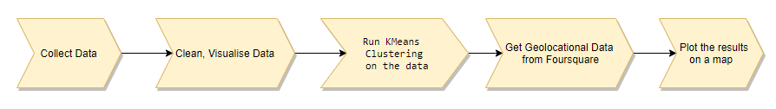
METHODOLOGY

Slide 6
PROJECT PLAN
High-Level Approach
Fetch Datasets from the relevant locations (Data Collection)
Clean the Datasets to prepare them for analysis. (Data Cleaning via Pandas)
Visualize data using boxplots. (Using Matplotlib /Seaborn /Pandas)
Fetch Geolocational Data from the Foursquare API. (REST APIs)
Use K-Means Clustering to cluster the locations (Using ScikitLearn)
Present findings on a map. (Using Folium/Seaborn)

Slide 7
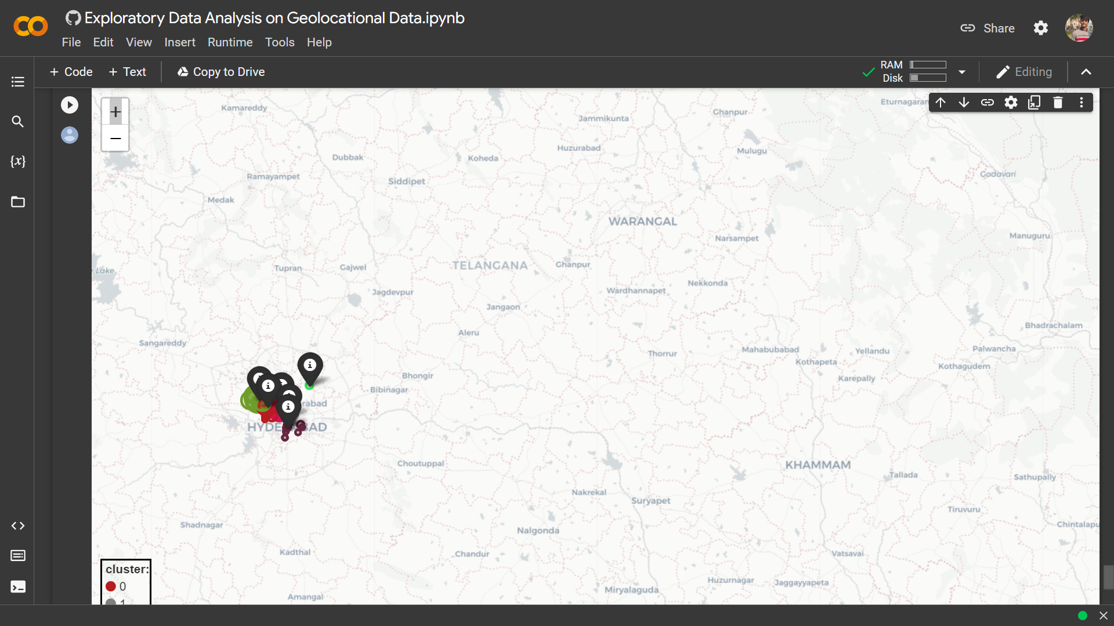
RESULT

Slide 8
REFERENCES
[1] Ajmera, Gourang, and Alok Singh. "Data Analysis using ML on Geolocational Data." (2021).

Slide 9
THANK YOU!

